Slide 1
COMPARATIVE STUDY TO SOLVE TEXT CATEGORIZATION
CES Data SCIENCE 2017-2018
Jacques DoaN huu

Slide 2
PROJECT MOTIVATION
DEEP LEARning OVERTAKES CLASSICAL TECHNIQUES in nLP domain
comparE Deep learning vs classical techniques to tackLe a REaL LIFE NLP Problem
Model accuracy
Model interpretability
TOOLING
SUSTAINABILITY
POSOS startup data challenge
Categorize TEXTS RELATED TO QUEStion on DRUG INTO 51 CLASSES
Few samples, MANY MISSPELLINGS, familiar writing style, drug specific vocabulary

Slide 3
WORKBENCH ENvironment
Jupyter / python as core environment
Python packages
Matplotlib / numpy / pandas
Ntlk / pyspellschecker
Sklearn / xgboost-GPU
Keras / tensorflow-GPU
Ressources
French Fasttext model
Ansm drug repository
Hardware
Macbook pro > 32-CORE PC > AWS GPU INSTance > PC GAMER (GTX 1050 GPU)

Slide 4
Data exploration
understanding data structure helps to define the appropriate learning procedure

Slide 5
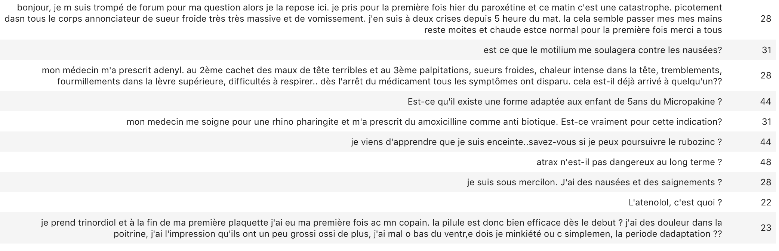
Text samples

Slide 6
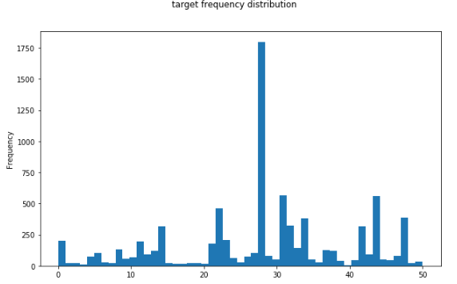
TARGET ANALYSIS
Imbalanced target distribution (51 classes)
Median is under 100 samples (really short)
8000 SAMPLES for training
Anonymized labels (1-51)

Slide 7
LABEL meaning/TOPIC EXTRACTION
Manual guess on Label semantic
1st mode : drug adverse effects
2d mode : drug-disease indication/efficiency
Automatic guess with Non negative factorization extraction
Each topic is characterized by an ordered set of components (words)
Good matching between extracted topics and manual guess
Topic #1 matches 1st mode
TOPIC components are leveraged later

Slide 8
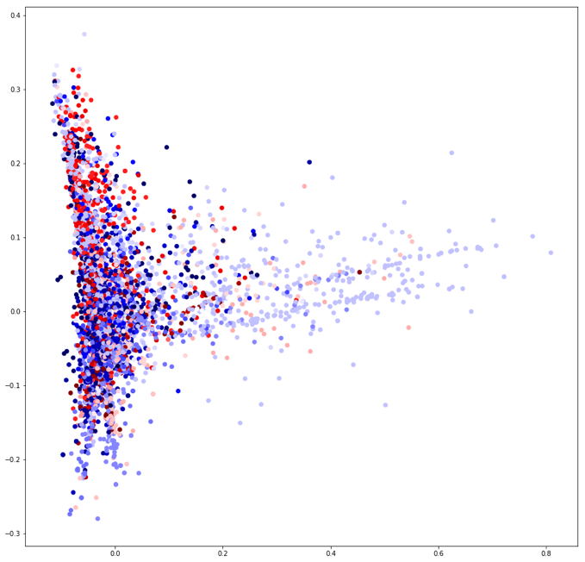
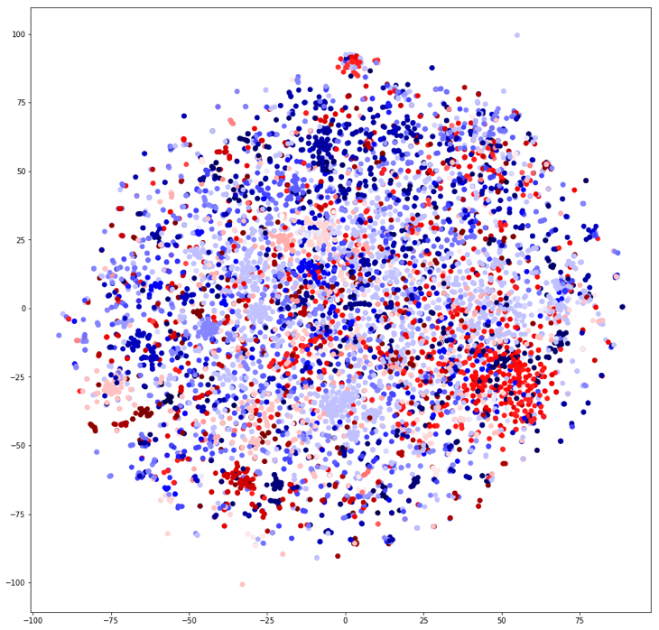
FEATURE SPACE DISTRIBUTION
2D features distribution visualization provides good hintS on classification task difficulty
T-SNE and PCA as dimension reduction
Per label clusters are not obviously separable
Simple bag of words representation is not enough
A more suitable rePresentation space to improve classification separability is required

Slide 9
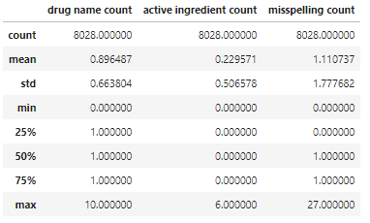
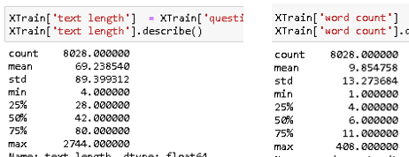

TEXT ANATOMY
Some statistics on training text corpus
Short text (word count mean = 10)
Significant misspelling rate (10%)
Multi-sentence document is mainly built in 2 phases
Several sentenceS to explicit the situation/Context
Out of context question sentence

Slide 10

Named entity statistics
Drug product name entity is mostly present
Ingredient name entity is poorly present
Among gold standard entity, time entity is frequent enough to be considered
Interrogative pronoun frequencies are imbalanced

Slide 11
DOCUMENT SIMILARITY
TODO
DOC2VEC
LDA

Slide 12

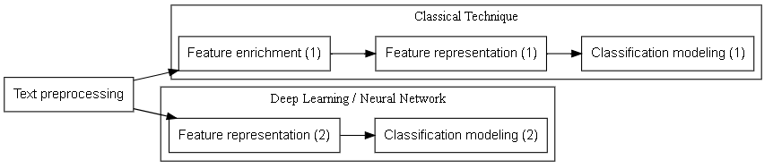
GLObal MODELING PIPELINE
GENErAL learning PIPELINE
Concrete learning pipeline implementation

Slide 13
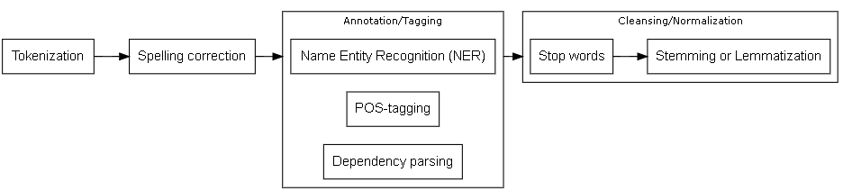
TEXT PREPROCESSING
General text preprocessing
In practice, the annotation step is slightly leveraged for this case study

Slide 14
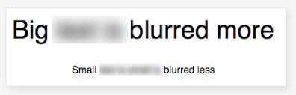
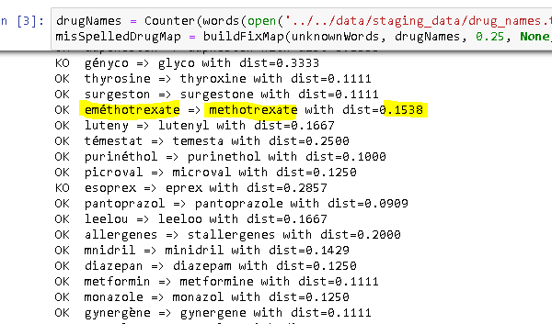
spelling correction
MisSpelled word blurs sentence meaning
Out of vocabulary words are considered as misspelled
Use fasttext vocabulary as reference
USE custom drug/ingredient vocabulary as reference too
Extracted from ANSM repository
Custom python code to find closest word from levenshtein distance point of view
583 unfixed words over Initial 2108 unknown words

Slide 15
TEXT ANNOTATION/TAGGING
Named entity recognition
Custom regular expressions (gold standard : time, interrogative pronoun, ….)
Domain based recognition of drug product and ingredient entities (ansm vocabulary)
Pos tagging
Not used, text context is supposed to be captured by sequence modeling
Dependency parsing
Not used, text context is supposed to be captured by sequence modeling
In general, french language is badly supported by NLP packages making difficult to exploit such metadata

Slide 16
Text cleansing / normalization
Vocabulary space size must to be reduced to make text workable for machine
Stopwords are applied to remove irrelevant/frequent words
Stemming is applied to collapse morphological variants into their root
It eliminates irrelevant semantic distance on features
Stemming is compatible with word embedding whose vocabulary is not stemmed

Slide 17
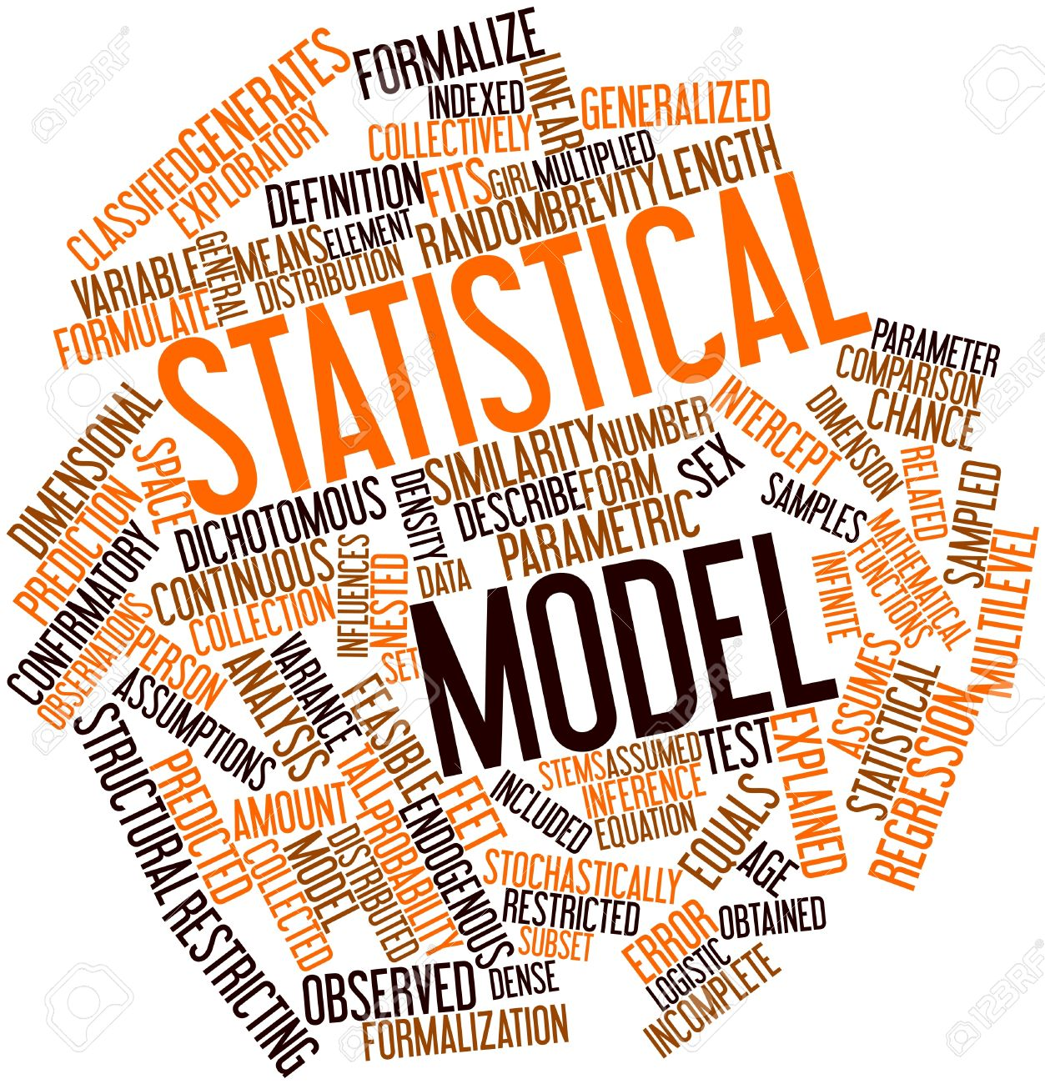
CLASSICAL TECHNIQUES
ALL TECHNIQUES which are not relying on neural network
SVM,Gradient boosting, Hidden markov model, …

Slide 18
Modeling elaboration
HMM (Hidden markov model) As sequence modeling is suitable for NLP
Few python implementation (hmms 0.1) and this method is difficult to exploit
Compensate sequence modeling discarding with manual feature engineering
Count and distance based statistics on specific named entities
Extracted topic likelihood features
Select xgboost as the best multi-purpose Classifier

Slide 19
Text vectorization
TF-IDF (Term frequency inverse document frequency)
Document is represented as a numerical vector in word space
Word order (context) is lost
Word co-occurrence is caught to explain target
PCA (principal component analysis) as fast linear dimension reduction
300 dimensional output space similarly to fasttext model

Slide 20
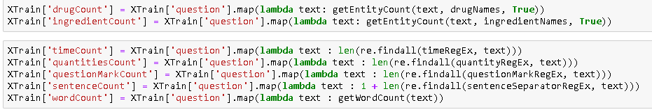
Text Statistics AS eXTRA FEATURE
Basic Statistics on text anatomy
Word count, sentence count, …
statistics on named entities
Named entities are identified by its domain or thanks to custom regular expressions
Count based statistics (drug product name, time, quantity, …)
distant based statistics (word distance between 2 entities)
It captures the relative word order on key entities

Slide 21
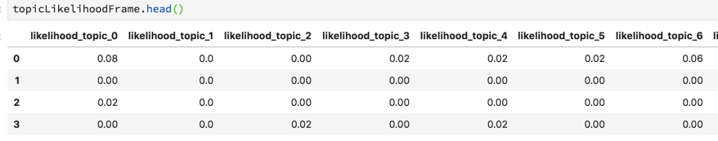
Topic likelihood feature
Extract 50 topics with nmf algorithm
Expect topic matches label or at least there’s a correlation
Compute the probability that a text is related to the topic as
P (TOPIC |TEXT) = intersect_count(WORDS(TEXT), topic_components)/ Count (topic_components)

Slide 22
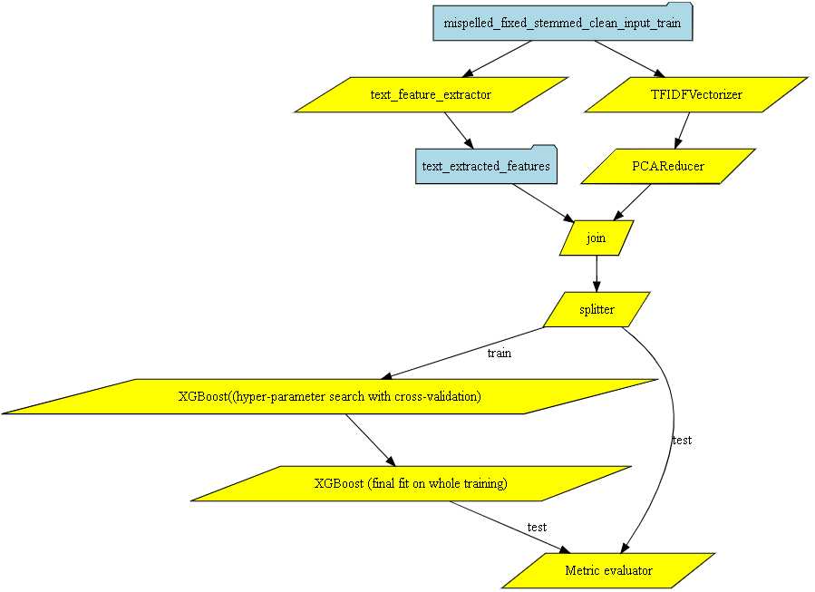
Classical method pipeline overview

Slide 23
hyper-parameters SEARCH
Focus on few instrumental hyper parameters
max_depth
min_child_weight
n_estimators
learning_rate (eta)
They are ‘grid-searched’ with Cross validated dataset to find the optimal values
Even with gPU acceleration, grid search was very slow

Slide 24
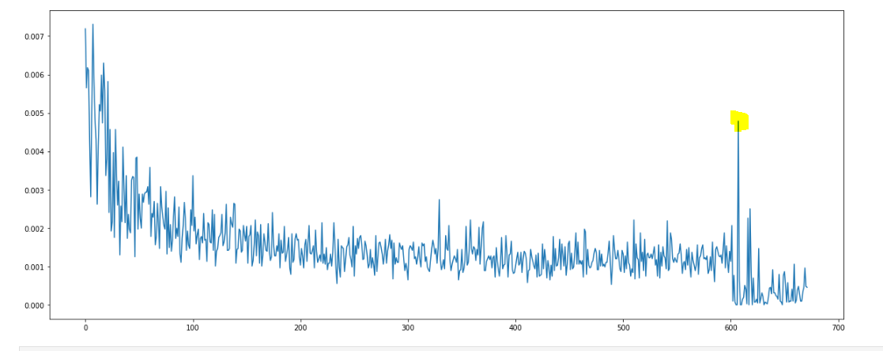
Performance resultS
Poor accuracy on test SET
micro F1-score macro F1-score support
0.63 0.44 1205
Micro Score is more meaningful for label imbalance case
EXTRA features (at the tail) have unexpectedly low explanatory importance

Slide 25
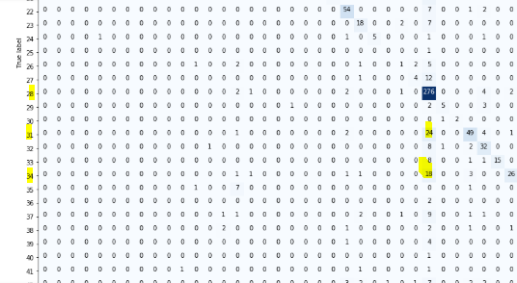
Contextual ambiguity
Confusion matrix shows high confusion between label 28 and 31
Label 28: drug-disease contraindication
Label 31: drug-disease indication
It confirms that learner doesn’t grasp context (in particular the negation here) and operates only on word co-occurrence

Slide 26
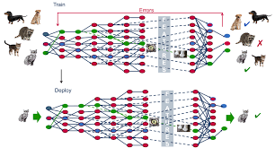
DEEP LEARNING
All-In-one modeling inspired from brain architecture

Slide 27
Modeling elaboration
Neural network is capable to model sequence
Document is represented as a n-gram structure of words
Word is itself vectorized into a n-dimensional numerical space

Slide 28
Text vectorization

Slide 29
Word embedding

Slide 30
Out of vocabulary

Slide 31
Architecture candidates
Dense neural network (dnn) as naive baseline
Ad-hoc word embedding
Non sequenCE modeling
Recurrent neural network (RNN/LSTM)
General word embedding + drug domain extension
Native sequence modeling
Convolutional neural network (CNN)
General word embedding + drug domain extension
2 VARIANTS: SEQUENTAL Or parallel ConvolutionaL layers
Simulated sequence modeling

Slide 32
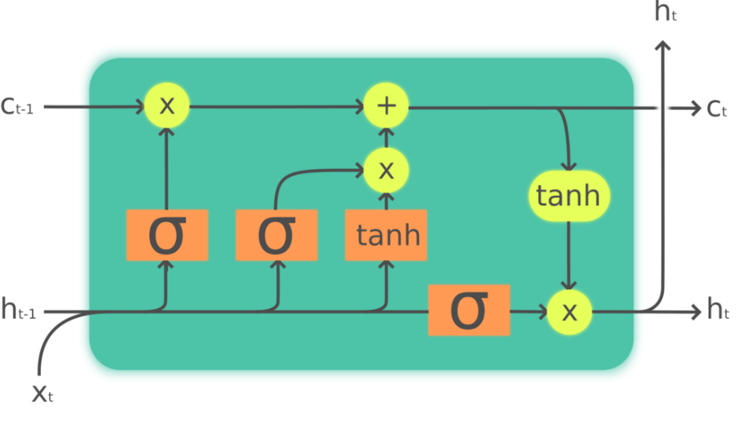
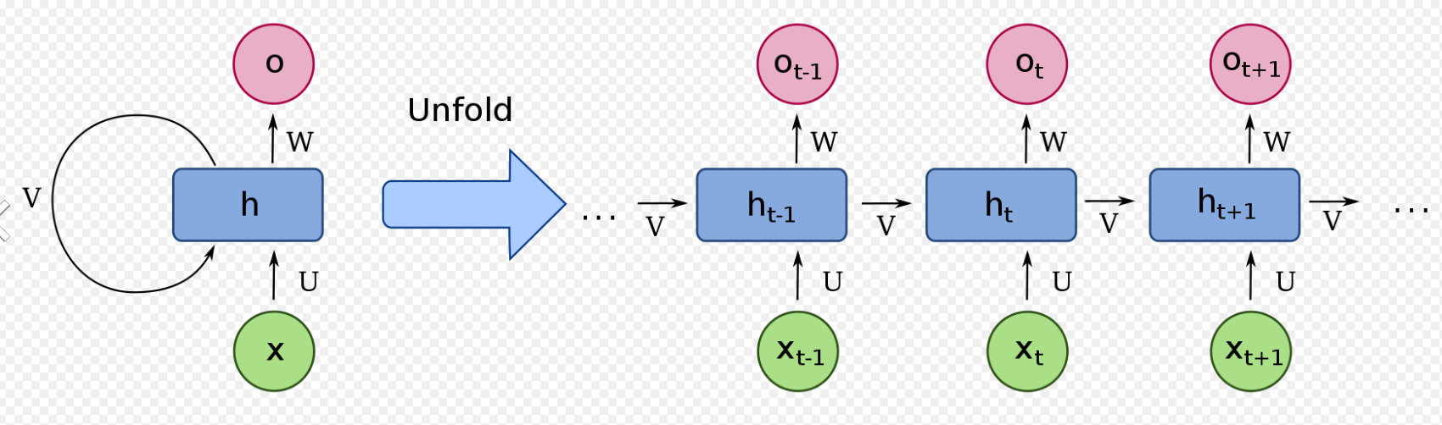
RNN / LSTM architecture
LSTM unit
Recurrent Neural Network

Slide 33
CNN architecture
// or sequential?

Slide 34
Hyper-parameters search

Slide 35
Performance results

Slide 36
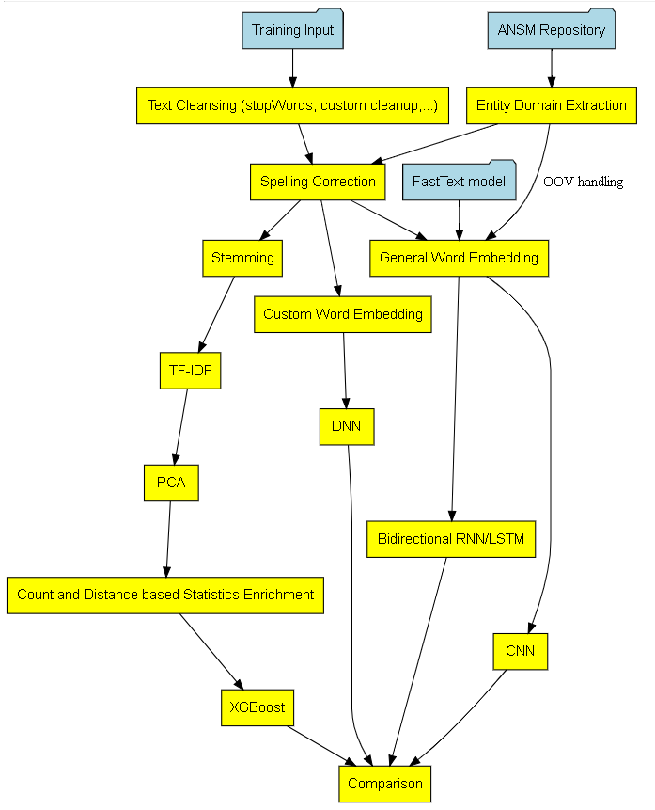
Modeling comparison

Slide 37
Model accuracy

Slide 38
Model interpretability

Slide 39
TOOLING

Slide 40
substainability

Slide 41
Winning/BEST practice
ACADEMIC Comparative study isolating techniques and their variants
Objective is to highlight their respective strength and weakness
BEST practice usually recommends to
Try several techniques and keep the one delivering the best performance
Combine them
Rnn and cnn architectures
Word embedding + manual feature extraction

Slide 42
SIMPLIFICATION : Binary classification

Slide 43
takeaways
Non conclusive performance results (65% micro F1-score)
Extracting sense from natural language is hard ( especially familiar french !)
Too few samples and too many target classes
Expect better gain with sequence modelinG
Unfair comparison favouring deep learning SOLUTION
rewarding Return of experience on key Data science methodology
DATA Exploration and analysis
Data preparation (feature representation)
Modeling/architecture selection
Hyper parameters search
Result analysis and improvement loop-back

Slide 44
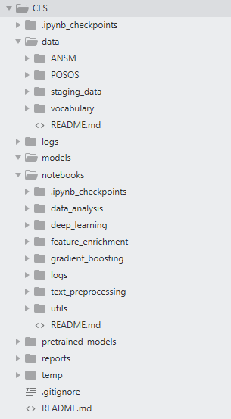
ANNEX
POSOS DATA CHALLENGE DESCRIBED AT
https://challengedata.ens.fr/fr/challenge/33/predisez_la_reponse_attendue.html
Runnable notebooks available at
https://github.com/jhuu32/CES

